Slide 1
Board of Selectmen Meeting
Central Street Improvements
MassDOT Project No. 608548
Monday, October 30, 2017
Presenters:
David L. Loring, P.E., ENV SP, LEED AP
Vice President, Tighe & Bond
Alexander D. Fagnand, P.E., ENV SP
Project Engineer, Tighe & Bond
Notes:
DLL

Slide 2
Project Description
Project Length – 2,600 Feet
Front Street to Maple Street (not including Blair Square)
Scope of Work ($3.5m – $3.75m)
Full Depth Roadway Reconstruction & Storm Drainage
Enhanced Pedestrian and Bicycle Accommodations
Streetscape Amenities
Municipal Sanitary Sewer & Water Main Replacement (non-participating local cost)
Funding Sources
FHWA Transportation Improvement Program (TIP) administered by MassDOT ($2.75m)
Local contribution for municipal utilities (approx. $750k - $1m)
Notes:
DLL

Slide 3
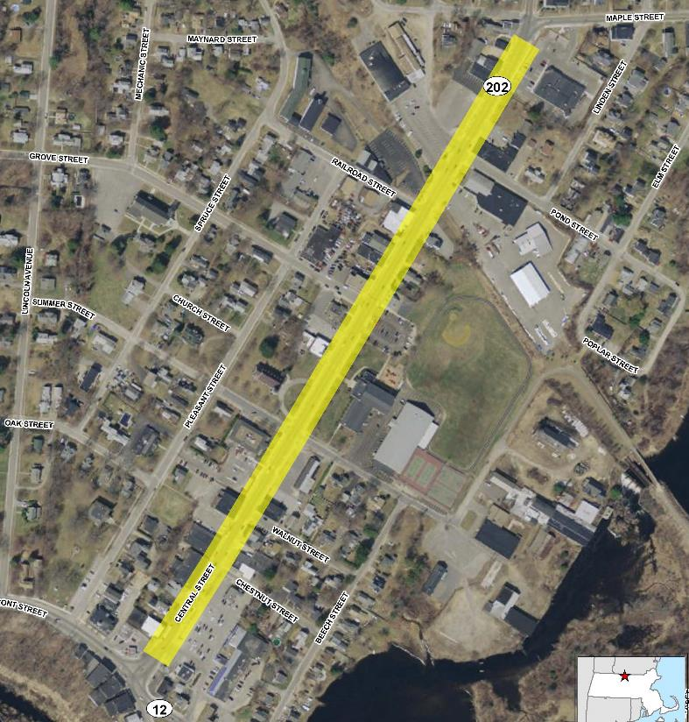
Locus Plan
Notes:
DLL

Slide 4
Existing Conditions
Roadway Characteristics
50-60’ Right of Way
Travel Lanes (2); Parking Lanes (2); Sidewalks (2)
Gentle grades
25 MPH Speed Limit
8,900 Vehicles per Day (ADT)
Pavement
Failing due to age, weak subbase, and poor drainage
Potholes; longitudinal cracks; alligator cracks
Utility trench repair patches
Utilities
Existing utilities are old and undersized
Recent repairs due to failures
Notes:
ADF

Slide 5
Corridor Deficiencies
Safety
High accident rate
State Average crash rate: 3.70 MEV
Central Street crash rate: 8.47 MEV
Intersection sight distance (ISD)
Dangerous pedestrian crossings
Multi-modal & ADA accommodations
Poor sidewalk condition; inadequate curb cut ramps
No dedicated bicycle space
Streetscape
Effective and aesthetic lighting
Plantings and street furniture
“Livable” space
Notes:
ADF
Biggest accident clusters at Summer & Grove

Slide 6
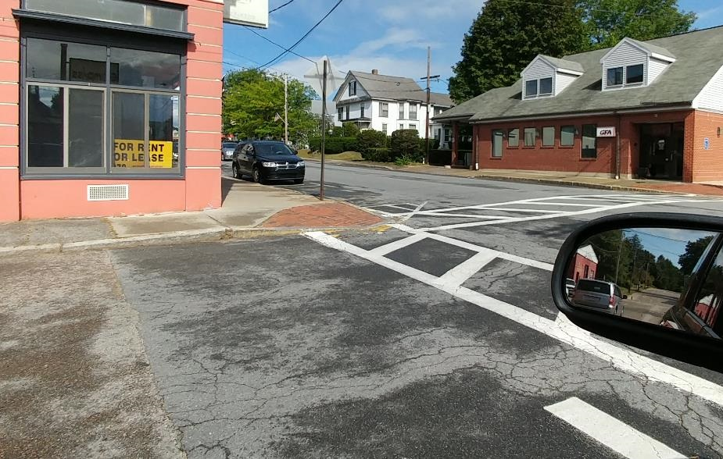
Typical Deficiencies
Intersection Sight Distance
ADA Compliance
Notes:
ADF

Slide 7
Public Input
Central Street Improvements Survey (Residents)
Conducted in person at 2017 Fall Fest with survey cards
Conducted online using Survey Monkey
32 responses
Town Meeting (Town Officials)
Presentation to Select Board and Planning Board
Continued Stakeholder Conversations
Local business owners
Direct project abutters
Regional Chamber of Commerce
Notes:
ADF

Slide 8
Survey Results
Why do you visit Central Street?
Notes:
ADF

Slide 9
Survey Results
What improvements would encourage you to visit more often?
Notes:
ADF

Slide 10






Survey Results
Please rank the following roadway improvements from 1 (most important) to 5.
Pedestrian
Parking
Bicycle
Landscaping
Bus
1
5
Notes:
ADF
1 – Pedestrian (3.72)
2 – Parking (3.25)
3 – Bicycle (3.17)
4 – Landscaping (3.04)
5 – Bus (1.83)

Slide 11
Survey Results
Speeding
“Currently, traffic moves too fast down Central Street…”
“Speeding. Central Street is thickly settled – 25 mph…”
Streetscape
“…plants plants plants…”
“Need to somehow tie each end of Central Street together…”
“Park benches. Better sidewalks. Outside dining…”
Blair Square
“Need rotary”
“A rotary at Central and Front…”
“…a traffic light at the intersection of Route 12…”
Notes:
ADF

Slide 12
Road Design
Engineering Practice & Principles
Review of pertinent guidance (State & Federal)
Application of engineering principles
Funding Program Requirements (TIP)
MassDOT project delivery & design review
Relevant Local Policies
Complete Streets Policy
Planned Development Relevant Local Policies
Local Stakeholder Input
Project Proponents (Planning & Development; DPW)
Town Officials (Select Board & Planning Board)
Residents & Local Business Owners
Notes:
ADF

Slide 13
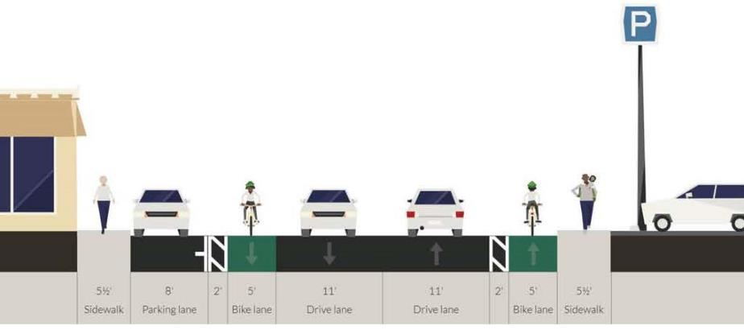
Road Design
Multi-modal Roadway Section
Travel lanes (2); Bicycle Lanes (2); Parking Lane (1); Sidewalks (2)
Parking lane on western side of the road
Adjacent to commercial store fronts
Eastern side has more off-street parking
Room for streetscape amenities
Notes:
ADF
“Parking Compromise”
Reduction in on street parking for
1. Safety improvements (ISD)
2. Multi-modal accommodations
3. Streetscape amenities
Mitigation of parking loss
Existing abundance of on-street parking
Additional off-street and side street parking
New short-term parking regulations

Slide 14
Next Steps
10% Design – November 2017
Finalize the FDR and meet with MassDOT
25% Design – January 2018
Preliminary Design to MassDOT & Design Public Hearing
75% Design – June 2018
Revised Design & Environmental/Land Use Permits
100% / PSE Design – December 2018
Revised Design & Construction Documents
Construction in Spring 2020
10% Design
(November ‘17)
25% Design
(January ‘18)
75% Design
(June ‘18)
100% / PSE Design
(December ‘18)
Construction
(Spring 2020)
Notes:
DLL

Slide 15
Summary
Opportunity to address Central Street Deficiencies
Accepting TIP funds means the Town must comply with MassDOT/FHWA design standards
Draw people back to downtown; spur on economic development
Downtown Complete Streets projects result in economic returns
Park Street in Adams
North Elm, Elm, and Main Street in Westfield
Notes:
DLL
Deficiencies (utilities, pedestrian, bicycle, safety, roadway)
Drawbacks (limited control of design process, conformance to state & national standards)
Benefits: leverage funding to improve corridor with utility improvements & economic growth

